Slide 1

How to deal with angry
customers ?
Sarah Büchner
Ibrahim Ounon
Pau Gallardo
Notes:
We would like to help companies, more especifically airline companies to manage this kind of customers.
In our Projec: deal with customer complaints. But how to do it?

Slide 2











DATABASE
Text
Tweet created
Airline
😃
Airline sentiment
😐
😠
Followers
Verified
Notes:
Our dataset from Kaggle: around 15k tweets from 2015 from the 6 main US-american airline companies.
Dataset with 18 columns where for our analysis the most important ones are :
The tweets(complexity of tweets will be explained later)
The airline Company,
the tweet creation timestamp (only 7 days period)
Thanks to webscrapping we gathered the number of followers per twitter account and if the account is verified or not. We have added this to our dataset. (illegal). We will explain in the next slides why this data is important to cope with clients.
Our target is the airline sentiment, which is a string variable that can be positive, negative or neutral. For this dataset people were asked to classify the tweet.
Our idea: thanks to text analytics we want to classify if the tweet is positive, negative or neutral.
Complexity

Slide 3
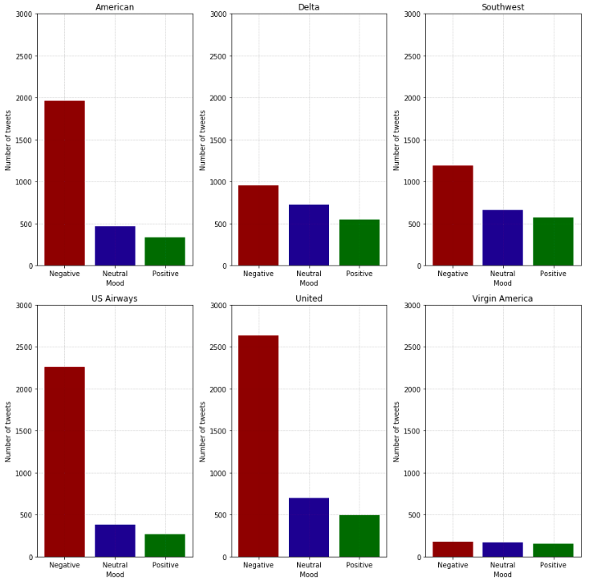
EDA
Base rate = 63.66%
Notes:
What we saw at first glance: Most tweets are negative, for all airlines > for some Airlines slightly imbalanced => Complexifies the implementation of our classifications
For airline companies neutral tweets and positive tweets are less relevant. Might also answer but less important >less impact on the organization.
Most impactful tweets for a company’s reputation are the negative ones. If not treated or not quickly enough can harm the organizations image/repuatation.

Slide 4
DM & ML
Precision-Recall Curves
- K-Neighbors = 0.49
- Logistic Regression = 0.64
- Decision Tree = 0.67
- Random Forest = 0.74
Precision
Recall
Notes:
We applied the methods that we saw in class for classification. Which are:
Logistic regression
K-Neighbors
Decsion Tree
Random Forest

Slide 5
TextBlob & Vader
Notes:
TestBlob&Vader
So, we tried to find other methods to qualify the tweets into sentiment categories:
-Good because : Emojis & intensity (capital letters & ponctuation) problems solved
-Not good because: Accuracy is not improving
Why:
We have still some of the challenges we had with the other classifiers (Joint text / hashtags, Irony, Abbreviated words, Ambiguity of words)
Also: Both classifiers provide output in float => that we then manually classified into neutral, positive and negative tweets. => subjective setting of thresholds.
This probably contributed to low accuracy rate.

Slide 6
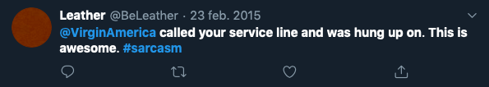
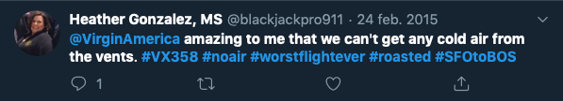
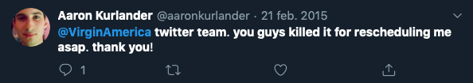
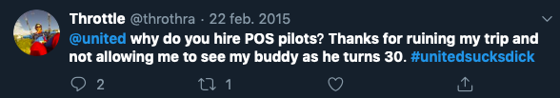
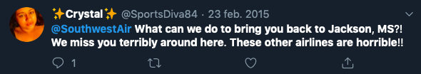
TWEET COMPLEXITY
Irony & sarcasm
Joint text in #
Ambiguity
Abbreviations
Intensity of words
Notes:
Challenges with tweet text: (ex: #worsttripever), emojis (not able to take into account when tokenized but provides much info), intensity of words (ponctuation, capital letters, ex: best/ BEST / BEST!!!), irony (), abbreviating words (pls for please), ambiguity of words (f.ex: killed > can be very good or very bad).
As mentioned before, unbalanced classes

Slide 7
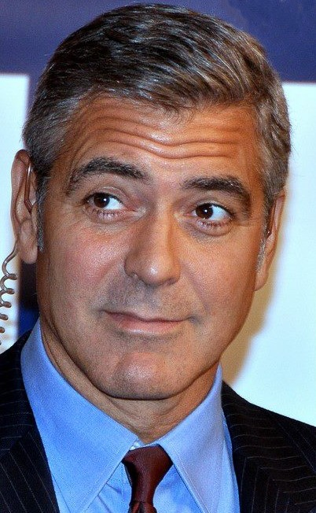


BUSINESS APPROACH
1) Level of negativity
😠
2) Followers
3) Verified
A celebrity
A student
Notes:
For any Company it is important to understand what customers think about there service.
Twitter is a media where many people express their opinions on experiences with airline companies.
In only 7 days there were thousands of tweets for each Company > impossible to treat all of them quickly
Prioritization=> Order of tweet treatment:
Ideally = Priced paid
Negativity
Scope: Followers and verified
We have added two additional columns to our data set (thanks to webscrapping):
- # of followers per twitter account => very important because the more followers the person has the most impact might have his/her tweets
If a twitter account is verified or not. => people with much influence => tweets from this account might have more impact

Slide 8



FURTHER IMPLEMENTATIONS
Market stock price prediction
Data deanonymization
Ethical considerations

